Slide 1

TOURIST PLACE RECOMMENDATION
WEB PROGRAMMING
GROUP-3

Slide 2
OUR TEAM
DEVANSHU KHEMKA 20BAI1319
HARDIK KATHURIA 20BAI1048
SARVESH SANJAY CHANDAK 20BAI1221
KRISH BAGGA 20BAI1044

Slide 3
TABLE OF CONTENTS
THE PROJECT
INTRODUCTION
BLOCK DIAGRAM
01
02
03
MODULES
WEB PAGES
COSCLUSION
04
05
06
Describe the topic of the section here
Describe the proposed system and methodology
Describe the system architecture
Describe the languages and software used
Shows all te pages of the website
Ends the project with enhancement

Slide 4
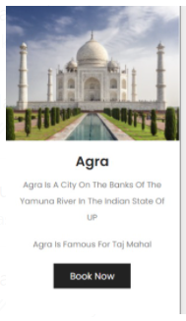
ABOUT THE PROJECT
This project is based on how an effective travel website will make us feel. It is based on a traveling website with fully-featured functions that will activate the traveling bug with vibrant imagery.
This website contains highlights of some important places along with high-quality photography and allows people to book their dream destination within their budgets. It also includes full customer support, vivid options, the customer can choose for there dream destination according to there age and status, also as per there time choice.
We will also try to include the full virtual tour of place through different videos and images.

Slide 5

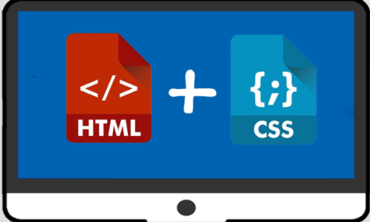



HERE IS WHAT WE ARE WORKING ON
HTML & CSS
JAVASCRIPT
PHP

Slide 6
—PAUL COOKSON
“Websites promote you 24/7: No employee will do that.”

Slide 7
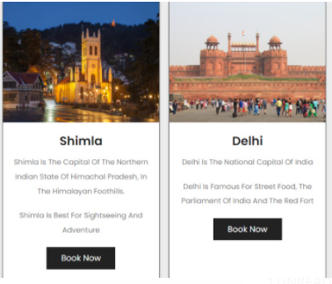
INTRODUCTION
Tourists can find tourism information on blogs, forums, websites of points of interest etc. However, information overflow can occur on the internet as there is still a lack of focus on the use of recommender technology in the tourism field.
During a trip, tourists need to be able to obtain tour information in a timely manner whenever there are any changes in their planned trip.
Recommendation of tour information is vital for users, for the recommendation system to succeed; it must be able to provide tourism information based on the user’s preferences and current location and so is our project.
. Our project is based on how an effective travel website will make us feel. It is based on a traveling website with fully-featured functions that will activate the traveling bug with vibrant imagery.

Slide 8
OBJECTIVES OF OUR PROJECT
To propose a framework for a place-based Tourist Recommender System.
System will take the input as tourist status and interested region using JavaScript and php.
Signed up user details recorded in the database. Next time just supposed to log in.
Specified region wise tourist places ranked depending upon their ratings and reviews.
Payment page with the total expenses (including travel, stay and meals).
User will select particular region to view its details

Slide 9
EXISTING SYSTEMS AND ITS LIMITATION
In the existing system and the websites, The user doesn’t get any recommendation of the locations they would want to visit as per their preference
The Existing system doesn’t allow the user to get a good recommendation of locations, the existing system lets the user choose interesting to visit BUT what it doesn’t do is suggest some or top locations from different regions of the country or even different countries from around the world.

Slide 10
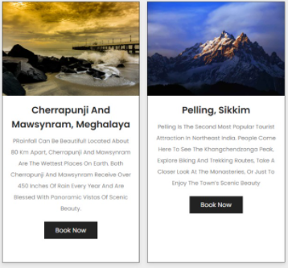
PROPOSED SYSTEM
Proposed system is an automated Community Book house Centre.
Proposed system deals with online registration of user to obtain services in library. For that first user needs to sign up in the system then after using proper login credentials he/she can made use to community room.
Through our software user can add books, search books, renewal, update information, edit information, and return books in quick time.

Slide 11
ADVANTAGES OF PROPOSED SYSTEM
1
4
User friendly interface.
Get the places ranked according to the ratings reviews and his status
2
3
Instead of checking in all over the nation, can look for a specific nation.
User can check the places according to his status.

Slide 12
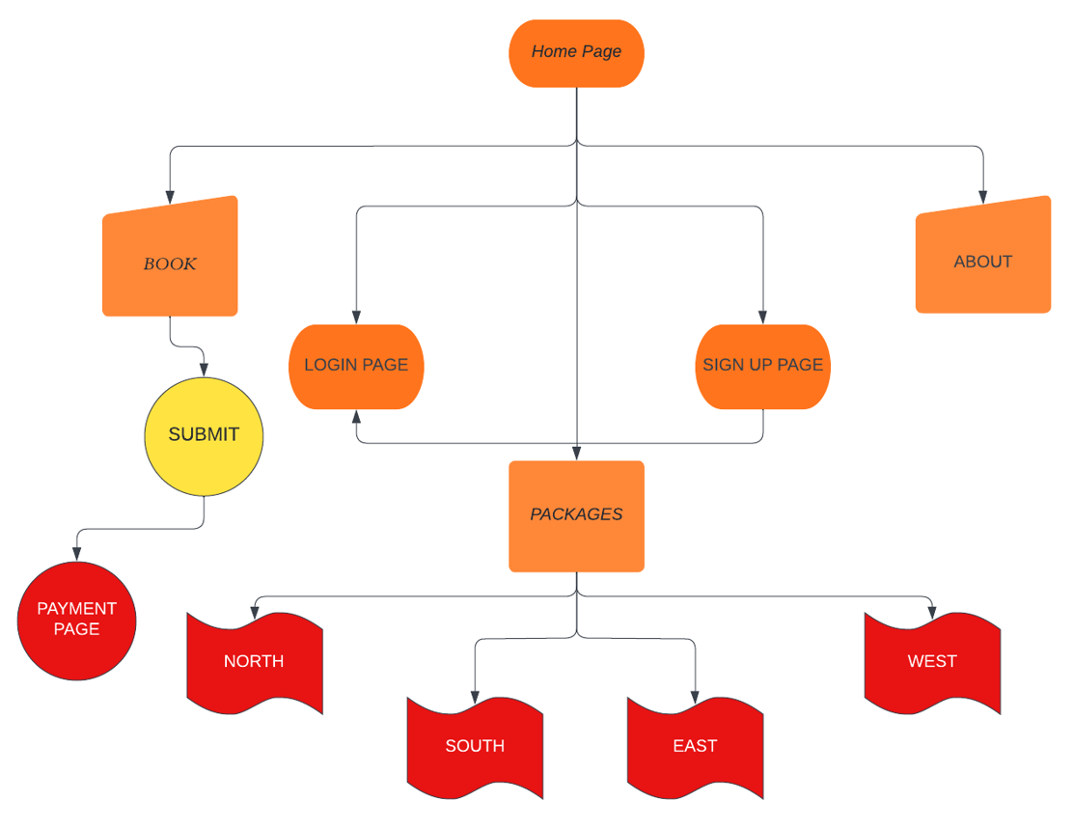
BLOCK DIAGRAM

Slide 13
SYSTEM ARCHITECTURE
When the user enters our website “TRAVEL.”, they get the option to either sign up or login in to an existing user profile to avail the facilities of our website and Travel’s tourist locations.
After they login the entries of their activities(Like which locations they selected, date, time and what time they logged in and logged out)
The user will select the location he wants to visit as per his/her choice and that information will be stored on his profile in the DATABASE.
So, the internal level or schema is the part of the of the system architecture which is not to end users but the actual information of database is stored in it.
External level or schema is the part visible to the users on their screen where they will have to first login and then enter their registered choices.

Slide 14


TECHNOLOGIES AND INTEGRATION
PHP
BOOTSTRAP
HTML/
CSS
MySQL

Slide 15
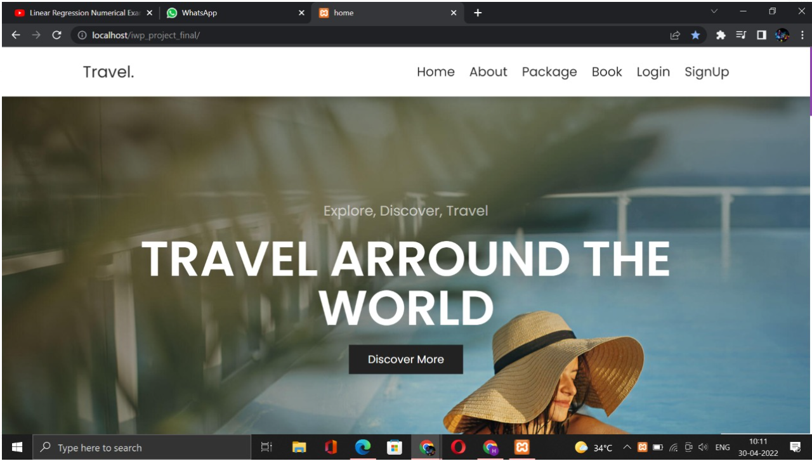

HOME PAGE

Slide 16
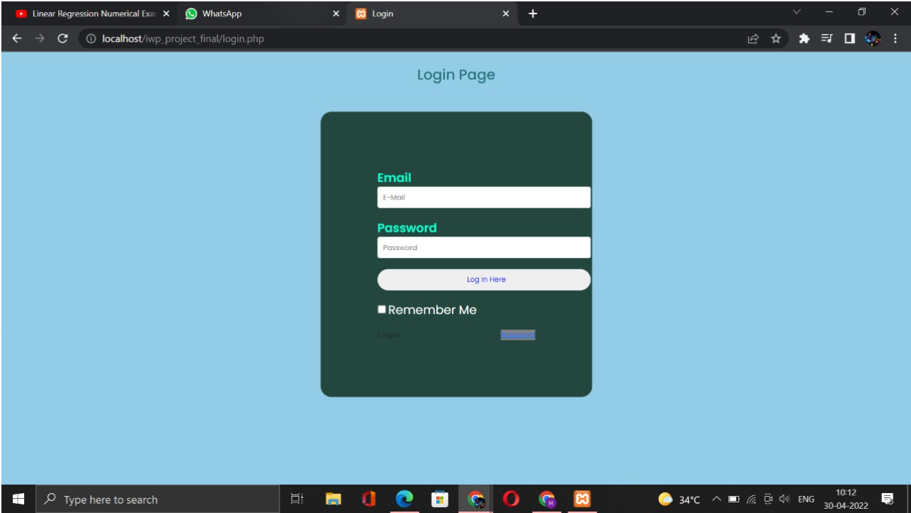
LOGIN PAGE

Slide 17
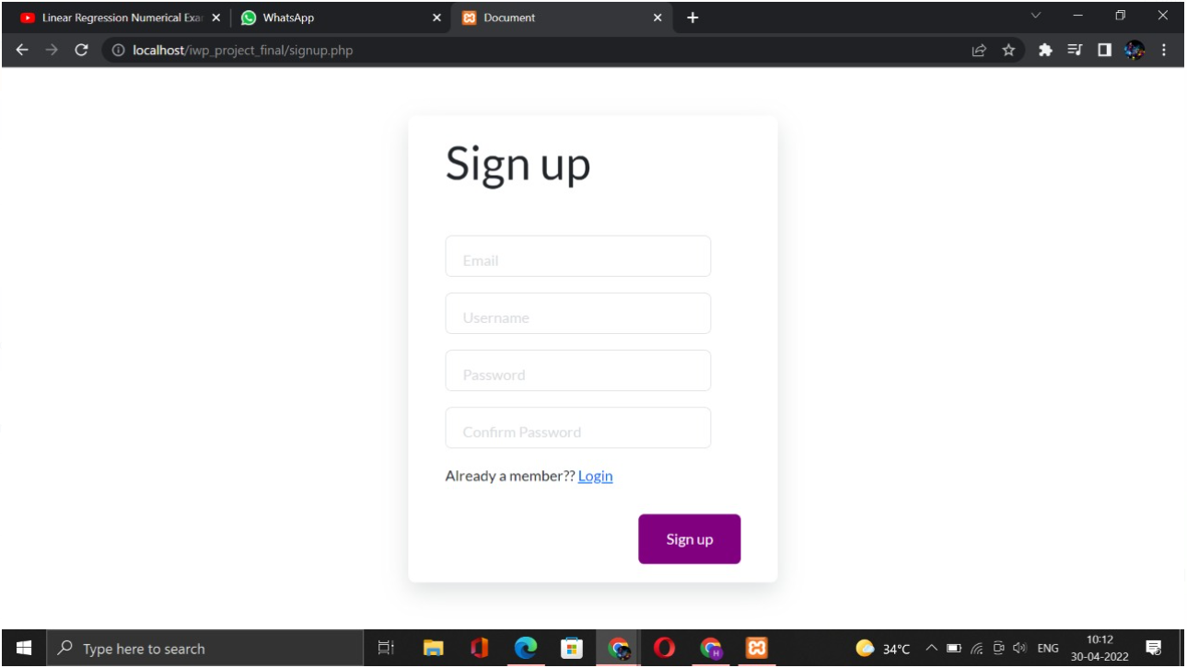
SIGN UP PAGE

Slide 18
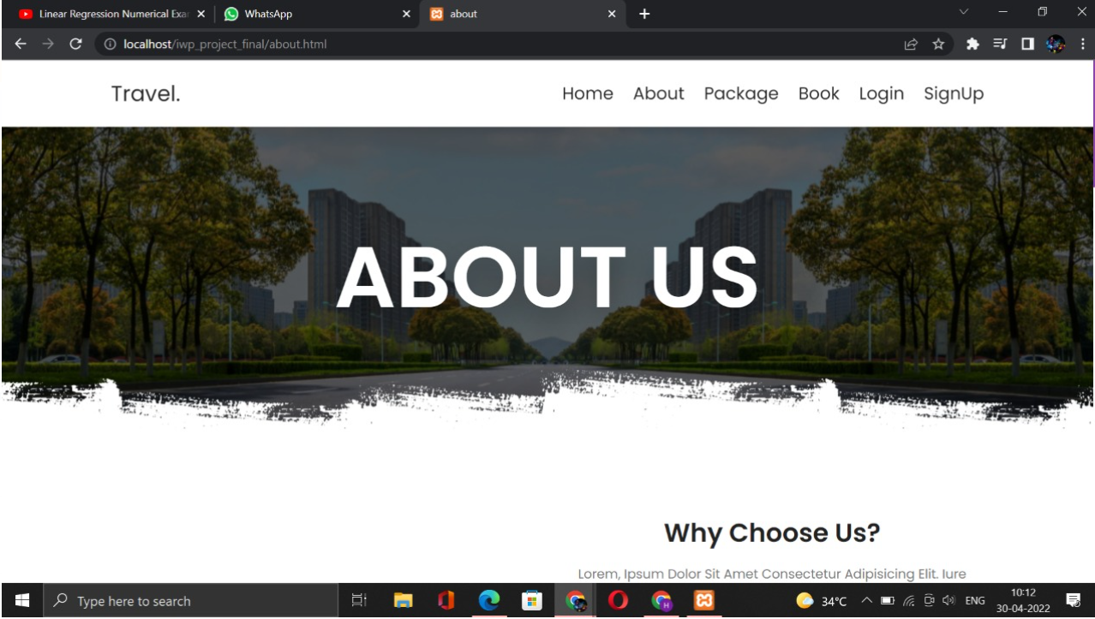
ABOUT US PAGE

Slide 19
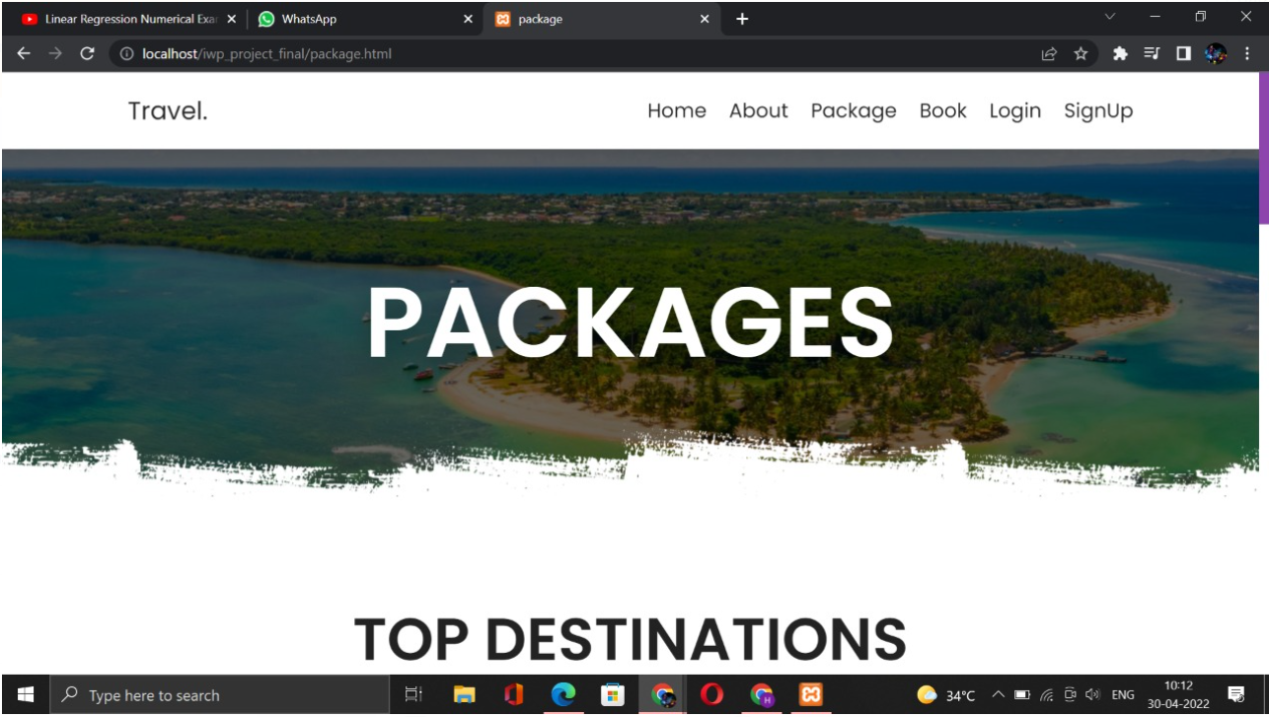
PACKAGES

Slide 20
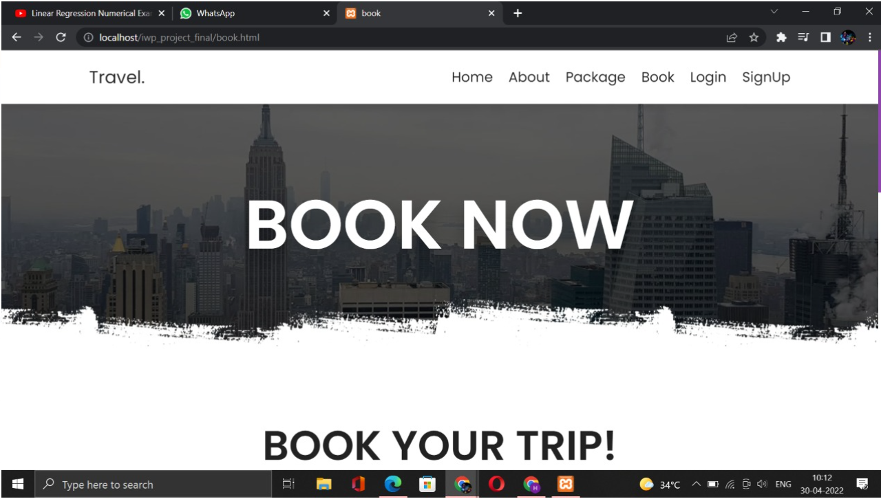
BOOKING PAGE

Slide 21
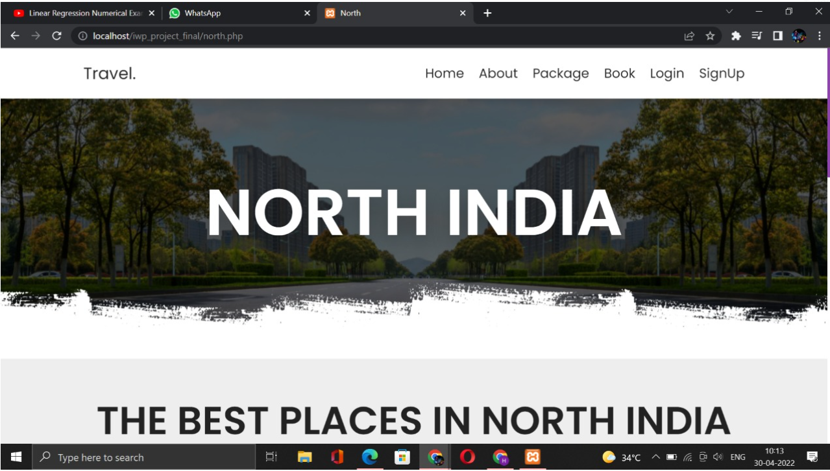
NORTH INDIA

Slide 22
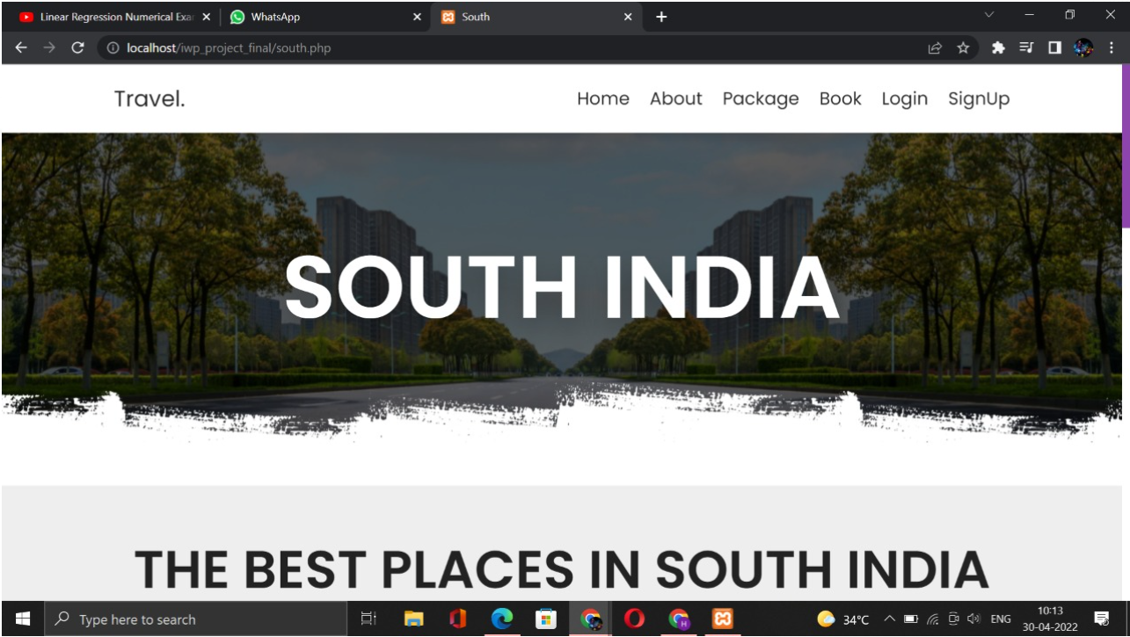
SOUTH INDIA

Slide 23
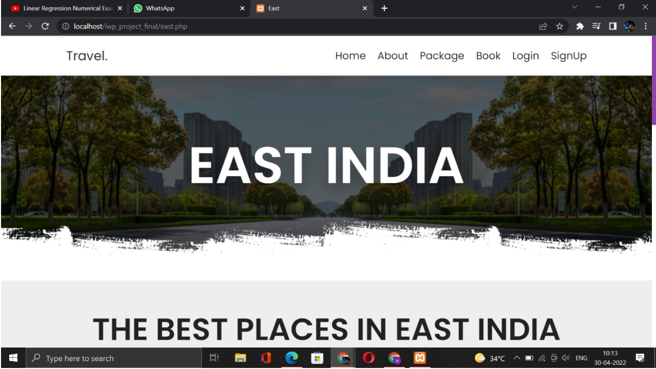
EAST INDIA

Slide 24
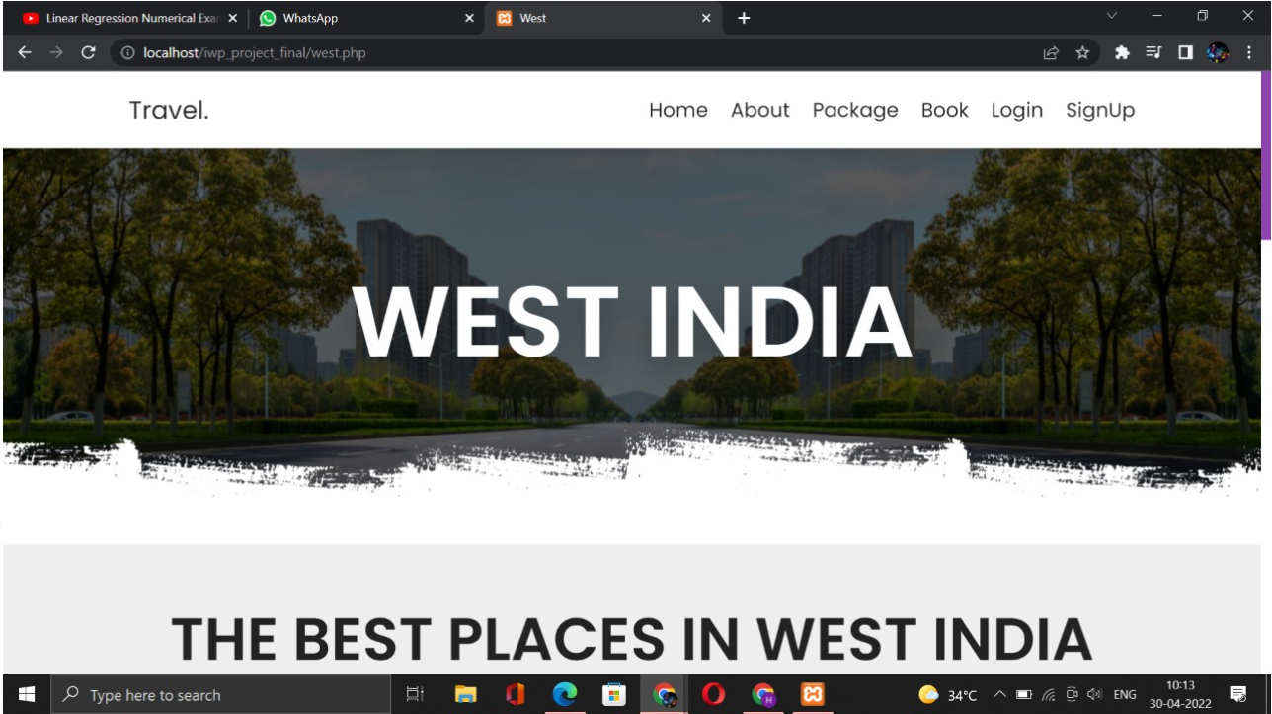
WEST INDIA

Slide 25
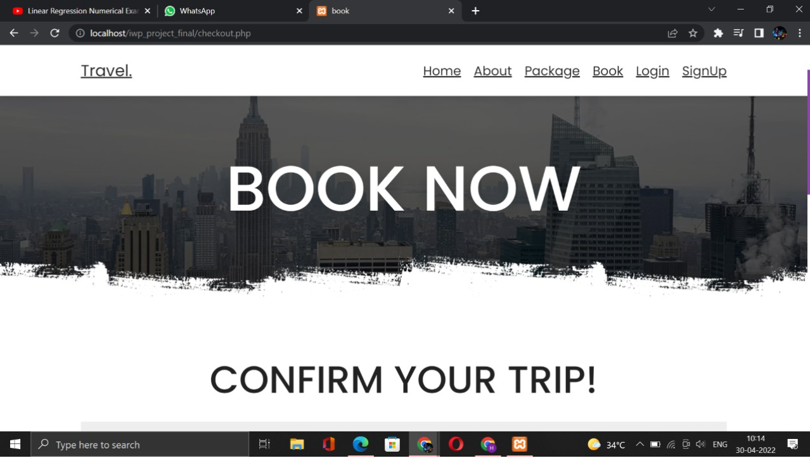
CONFIRM BOOKING PAGE

Slide 26
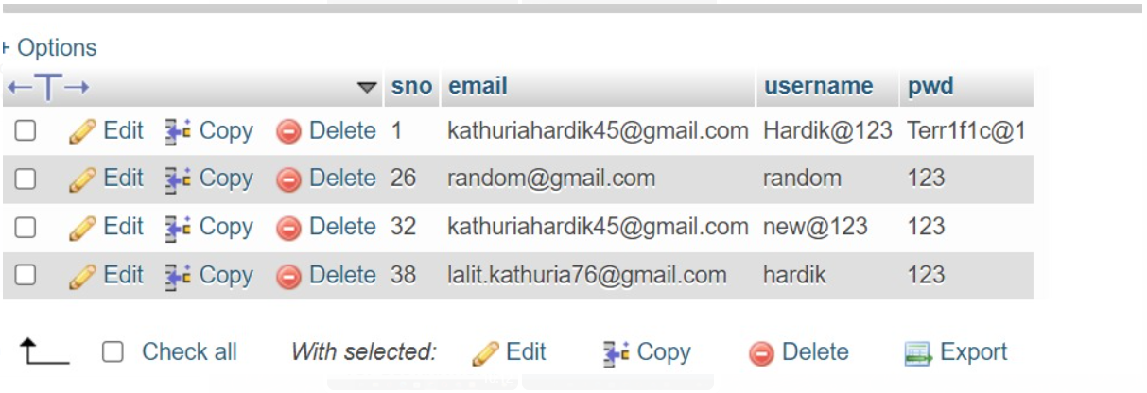
DATABASE-1

Slide 27
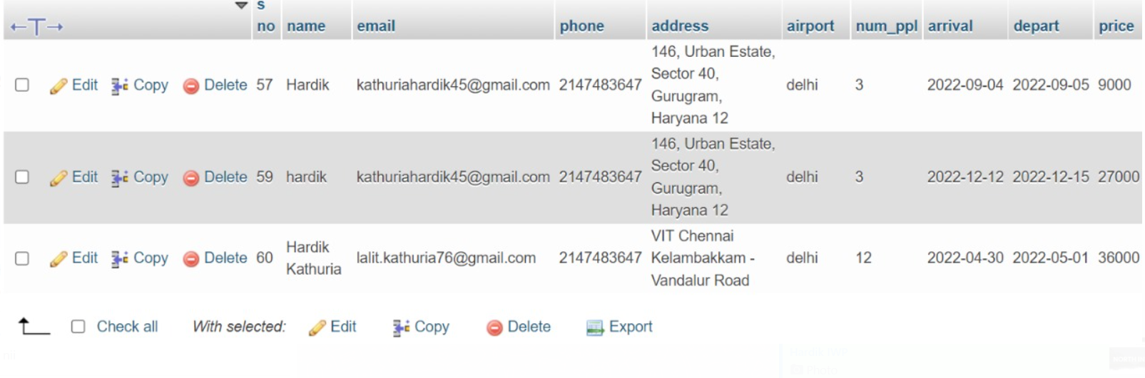
DATABASE-2

Slide 28
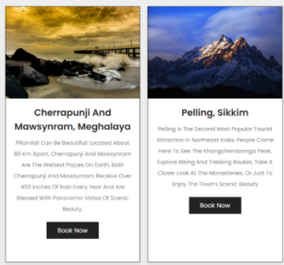
CONCLUSION
This website offers a chance to explore India and let people plan their tour effortlessly. From planning for a vacation to purchasing travel packages, the website has all of it.
It also provides us an opportunity to maintain a user database and make their experience easy and seamless.
The user need not worry about booking their hotels or travelling from one place to another. Our travel packages got them covered.
Tourists can select which part of India they want to visit, and our website will suggest them places worth visiting, let it be adventure, trekking, temples, etc.
In future, we can include an algorithm that gives personalized suggestions to user about travel places and tour packages based on his/her past purchases and searches. The website can be made dynamic, and more tourist places can be added.

Slide 29
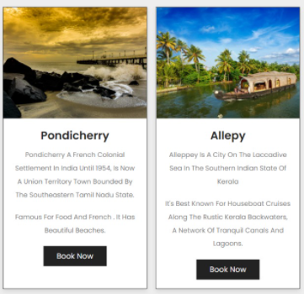

THANKS!
FOR ANY QUERIES MAIL AT
Devanshu.khemka2020@vitstudent.ac.in
+91 7693891442

